Slide 1

Introduction to the transformer
Most popular state-of-the-art deep learning architectures.
It has replaced RNN and LSTM for various tasks.
BERT, GPT, and T5, are based on the transformer architecture.

Slide 2
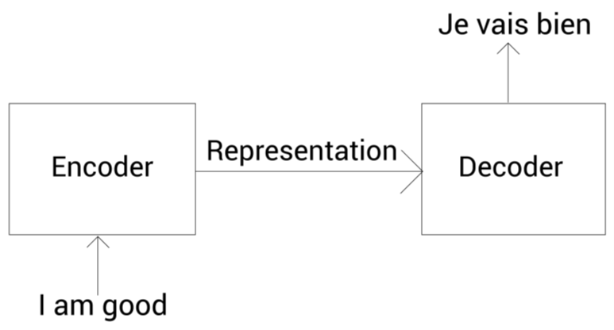
Introduction to the transformer
Transformer was introduced in the paper Attention Is All You Need.

Slide 3
Introduction to the transformer
The transformer consists of an encoder-decoder architecture. We feed the input sentence (source sentence) to the encoder.
The encoder learns the representation of the input sentence and sends the representation to the decoder.
The decoder receives the representation learned by the encoder as input and generates the output sentence (target sentence).

Slide 4
Understanding the encoder of the transformer
The transformer consists of a stack of number of encoders.
Each encoder sends its output to the encoder above it.
The final encoder returns the representation of the given source sentence as output.

Slide 5

Understanding the encoder of the transformer

Slide 6
Understanding the encoder of the transformer
Each encoder block consists of two sublayers:
Multi-head attention
Feedforward network

Slide 7

Understanding the encoder of the transformer

Slide 8
Self-attention mechanism
A dog ate the food because it was hungry
While computing the representation of each word, it relates each word to all other words in the sentence to understand more about the word.

Slide 9
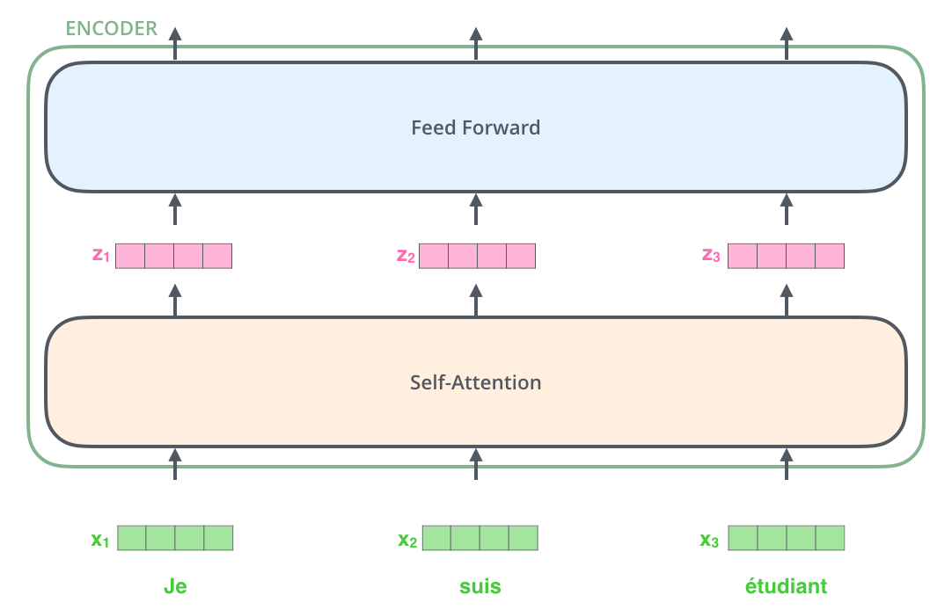
Self-attention mechanism
The word at each position passes through a self-attention process.
Then, they each pass through a feed-forward neural network.

Slide 10
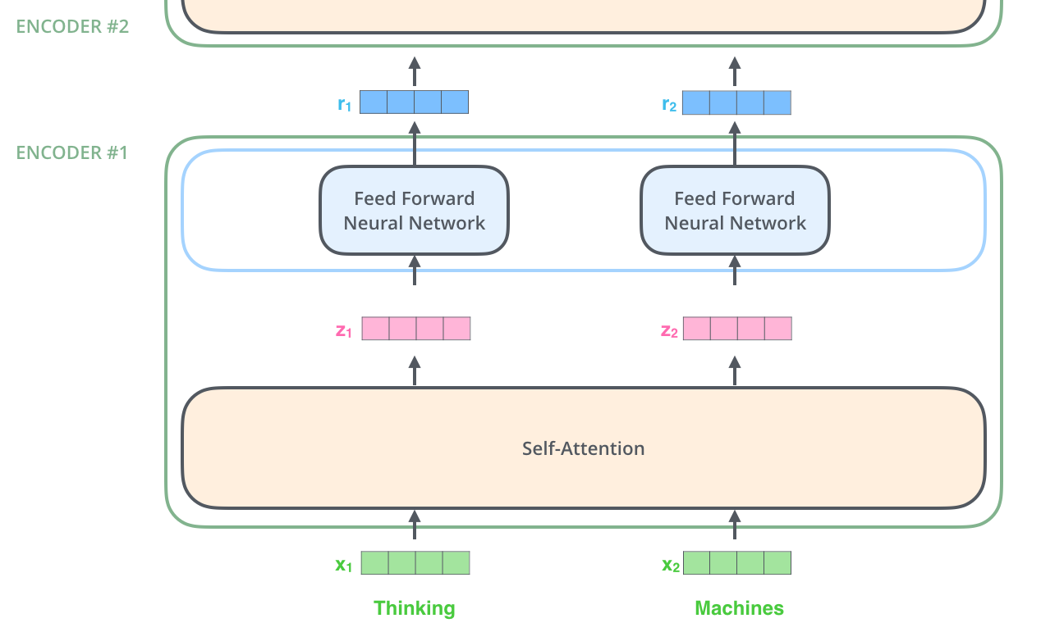
Self-attention mechanism

Slide 11
Self-attention mechanism

Slide 12
Self-Attention in Detail
Self-attention mechanism
The first step in calculating self-attention is to create three vectors from each of the encoder’s input vectors
For each word, we create a Query vector, a Key vector, and a Value vector.
These vectors are created by multiplying the embedding by three matrices that we trained during the training process.

Slide 13
Understanding the self-attention mechanism
The first row in the query, key, and value matrices implies the query, key, and value vectors of the word I.
Dimensionality of the query, key, value vectors are 64.

Slide 14
Step 1

Slide 15
Step 1
Dot product between the query vector ( q1) and the key vectors(k1,k2,k3)

Slide 16
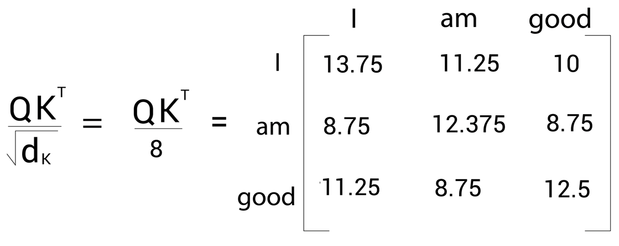
Step 2
The next step in the self-attention mechanism is to divide the matrix by the square root of the dimension of the key vector.

Slide 17
Step 3
we normalize them using the softmax function.

Slide 18
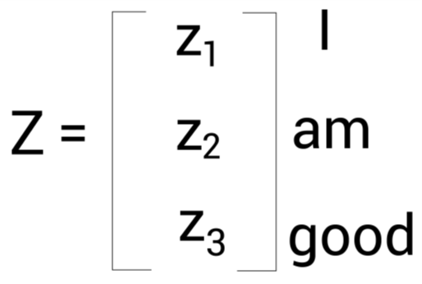
Step 4
Compute the attention matrix Z

Slide 19
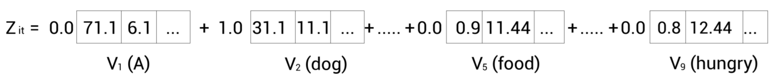

Slide 20
Self Attention mechanism

Slide 21

Multi head Attention mechanism

Slide 22
Learning position with positional encoding
Instead of feeding the input matrix directly to the transformer, we need to add some information indicating the word order

Slide 23
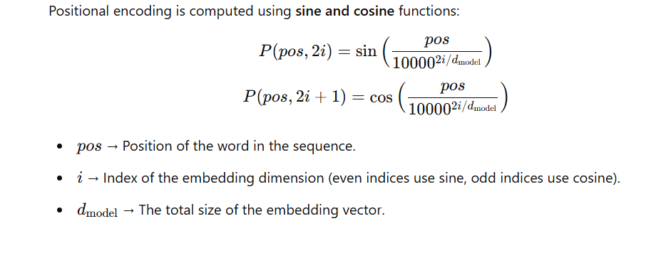

Slide 24
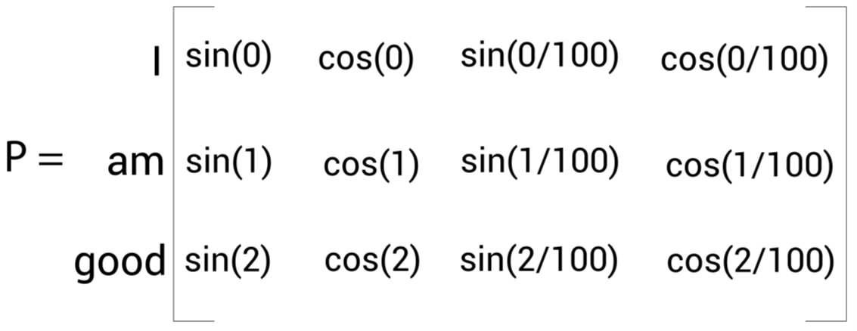
Learning position with positional encoding

Slide 26
A single encoder block

Slide 27
Add and norm component
Layer normalization promotes faster training by preventing the values in each layer from changing heavily.

Slide 28
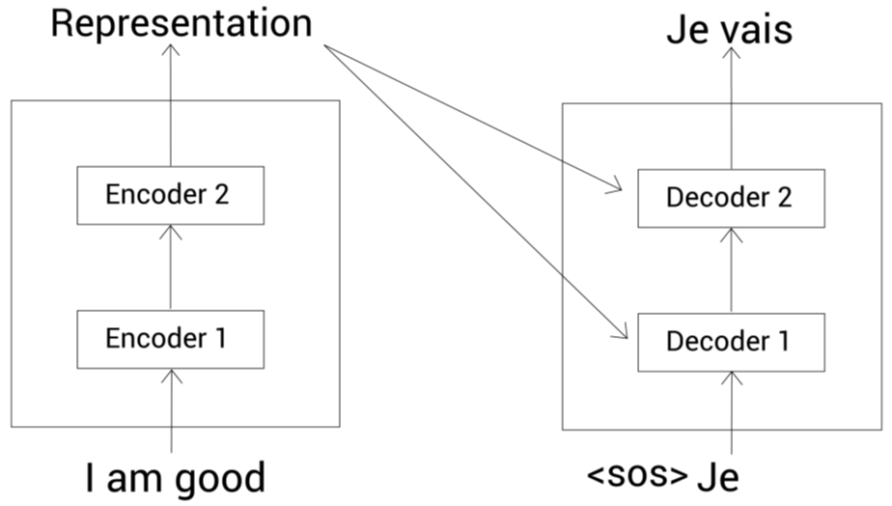
Understanding the decoder of a transformer

Slide 29
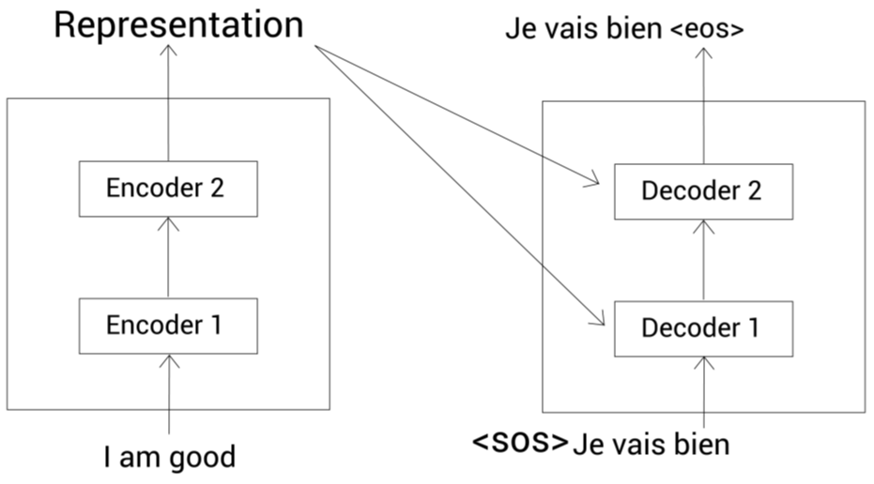
Understanding the decoder of a transformer

Slide 30
The BERT Model

Slide 31
Understanding the BERT Model
BERT stands for Bidirectional Encoder Representation from Transformer.
It is the state-of-the-art embedding model published by Google.
It is a context-based embedding model
He got bit by Python.
Python is my favorite programming language
The encoder of the transformer is bidirectional in nature since it can read a sentence in both directions.

Slide 32
BERT generating the representation of each word in the sentence
Feed the sentence as an input to the transformer's encoder and get the representation of each word in the sentence as an output.

Slide 33
Configurations of BERT
BERT-base consists of 12 encoder layers, each stacked one on top of the other. All the encoders use 12 attention heads. The feedforward network in the encoder consists of 768 hidden units. Thus, the size of the representation obtained from BERT-base will be 768.
BERT-large consists of 24 encoder layers, each stacked one on top of the other. All the encoders use 16 attention heads. The feedforward network in the encoder consists of 1,024 hidden units. Thus, the size of the representation obtained from BERT-large will be 1,024.

Slide 34
Other configurations of BERT
Bert-tiny, with L=2 and H=128
Bert-mini, with L=4 and H=256
Bert-small, with L=4 and H=512
Bert-medium, with L=8 and H=512

Slide 35
Other configurations of BERT

Slide 36
Pre-training the BERT model
what does pre-training mean?
First, we train a model M with a huge dataset for a particular task and save the trained model.
For a new task, instead of initializing a new model with random weights, we will initialize the model with the weights of our already trained model M.
This is a type of transfer learning.

Slide 37
Pre-training the BERT model
The BERT model is pre-trained on a huge corpus using two interesting tasks, called masked language modeling and next sentence prediction. Following pre-training, we save the pretrained BERT model.
For a new task, say question answering, instead of training BERT from scratch, we will use the pre-trained BERT model.

Slide 38
Pre-training the BERT model

Slide 39
Input data representation
Token embedding
Segment embedding
Position embedding

Slide 40
Token embedding
Sentence A: Paris is a beautiful city.
Sentence B: I love Paris.
tokens = [Paris, is, a, beautiful, city, I, love, Paris]
tokens = [ [CLS], Paris, is, a, beautiful, city, I, love, Paris]
tokens = [ [CLS], Paris, is, a, beautiful, city, [SEP], I, love, Paris,[SEP]]
The [CLS] token is used for classification tasks and the [SEP] token is used to indicate the end of every sentence

Slide 41
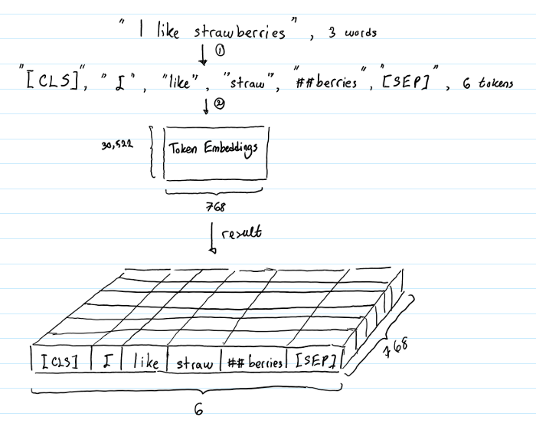
Token embedding
The role of the Token Embeddings layer is to transform words into vector representations of fixed dimension. In the case of BERT, each word is represented as a 768-dimensional vector.

Slide 42
WordPiece tokenizer
The tokenization is done using a method called WordPiece tokenization.
When we tokenize using the WordPiece tokenizer, first we check whether the word is present in our vocabulary.
If the word is not present in the vocabulary, then we split the word into subwords.
if the subword is not present in the vocabulary, then again we split the subword. This is effective in handling the out-of-vocabulary

Slide 43
Token embedding
The size of the BERT vocabulary is 30K tokens. If a word belongs to these 30K tokens, then we use it as a token.
tokens = [let, us, start, pre, ##train, ##ing, the, model]
tokens = [ [CLS], let, us, start, pre, ##train, ##ing, the model, [SEP] ]

Slide 44
Final representation

Slide 45
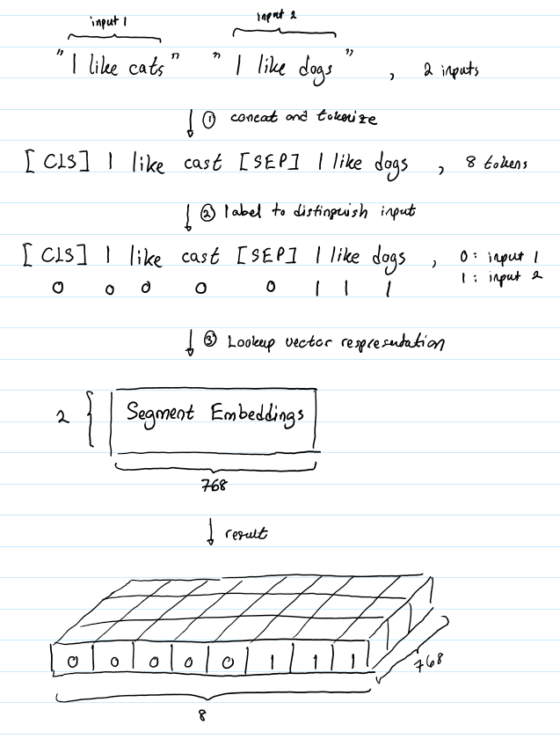
Segment embedding

Slide 46
Pre-training strategies
Masked language modeling
Next sentence prediction

Slide 47
Auto-regressive language modeling
Paris is a beautiful __. I love Paris
Forward (left-to-right) prediction
Paris is a beautiful __.
Backward (right-to-left) prediction
__. I love Paris

Slide 48
Auto-encoding language modeling
Auto-encoding language modeling takes advantage of both forward (left-to-right) and backward (right-to-left) prediction.
Bidirectional in nature
BERT is an auto-encoding language model,

Slide 49
Masked language modeling
First, we tokenize the sentences
tokens = [Paris, is, a beautiful, city, I, love, Paris]
tokens = [ [CLS], Paris, is, a beautiful, city, [SEP], I, love, Paris,[SEP] ]
tokens = [ [CLS], Paris, is, a beautiful, [MASK], [SEP], I, love, Paris,[SEP] ]

Slide 50
BERT Model

Slide 51
BERT Model
We feed the input embeddings to BERT.
BERT takes the input and returns a representation of each token as an output
To predict the masked token, we feed the representation of the masked token returned by BERT to the feedforward network with a softmax activation.

Slide 52
BERT Model
The feed forward network takes as input and returns the probability of all the words in our vocabulary to be the masked word

Slide 53
Next sentence prediction
NSP is a binary classification task.
In the NSP task, we feed two sentences to BERT and it has to predict whether the second sentence is the next sentence of the first sentence.

Slide 54
Next sentence prediction
In the NSP task, the goal of our model is to predict whether the sentence pair belongs to the isNext or notNext category.
We feed the sentence pair (sentences A and B) to BERT and train it to predict whether sentence B follows on from sentence A.

Slide 55
Next sentence prediction

Slide 56
NSP task
Over a series of iterations, with backpropagation, we update the weights of the feedforward network and the encoder layers of BERT and learn the optimal weights

Slide 57
Pre-training procedure
BERT is pre-trained using Toronto BookCorpus and the Wikipedia dataset
First, we sample two sentences (two text spans) from the corpus. Let's say we sampled two sentences A and B.
Total number of tokens from the two sentences A and B should be less than or equal to 512.
We tokenize and mask 15% of tokens. We feed the tokens to BERT and train BERT in predicting the masked tokens and also to classify whether sentence B is the follow-up sentence to sentence A.

Slide 58
References
Getting Started with Google BERT Sudharsan Ravichandiran
https://mccormickml.com/
https://jalammar.github.io/illustrated-transformer/
https://papers.nips.cc/paper/2017/file/3f5ee243547dee91fbd053c1c4a845aa-Paper.pdf

